Slide 1
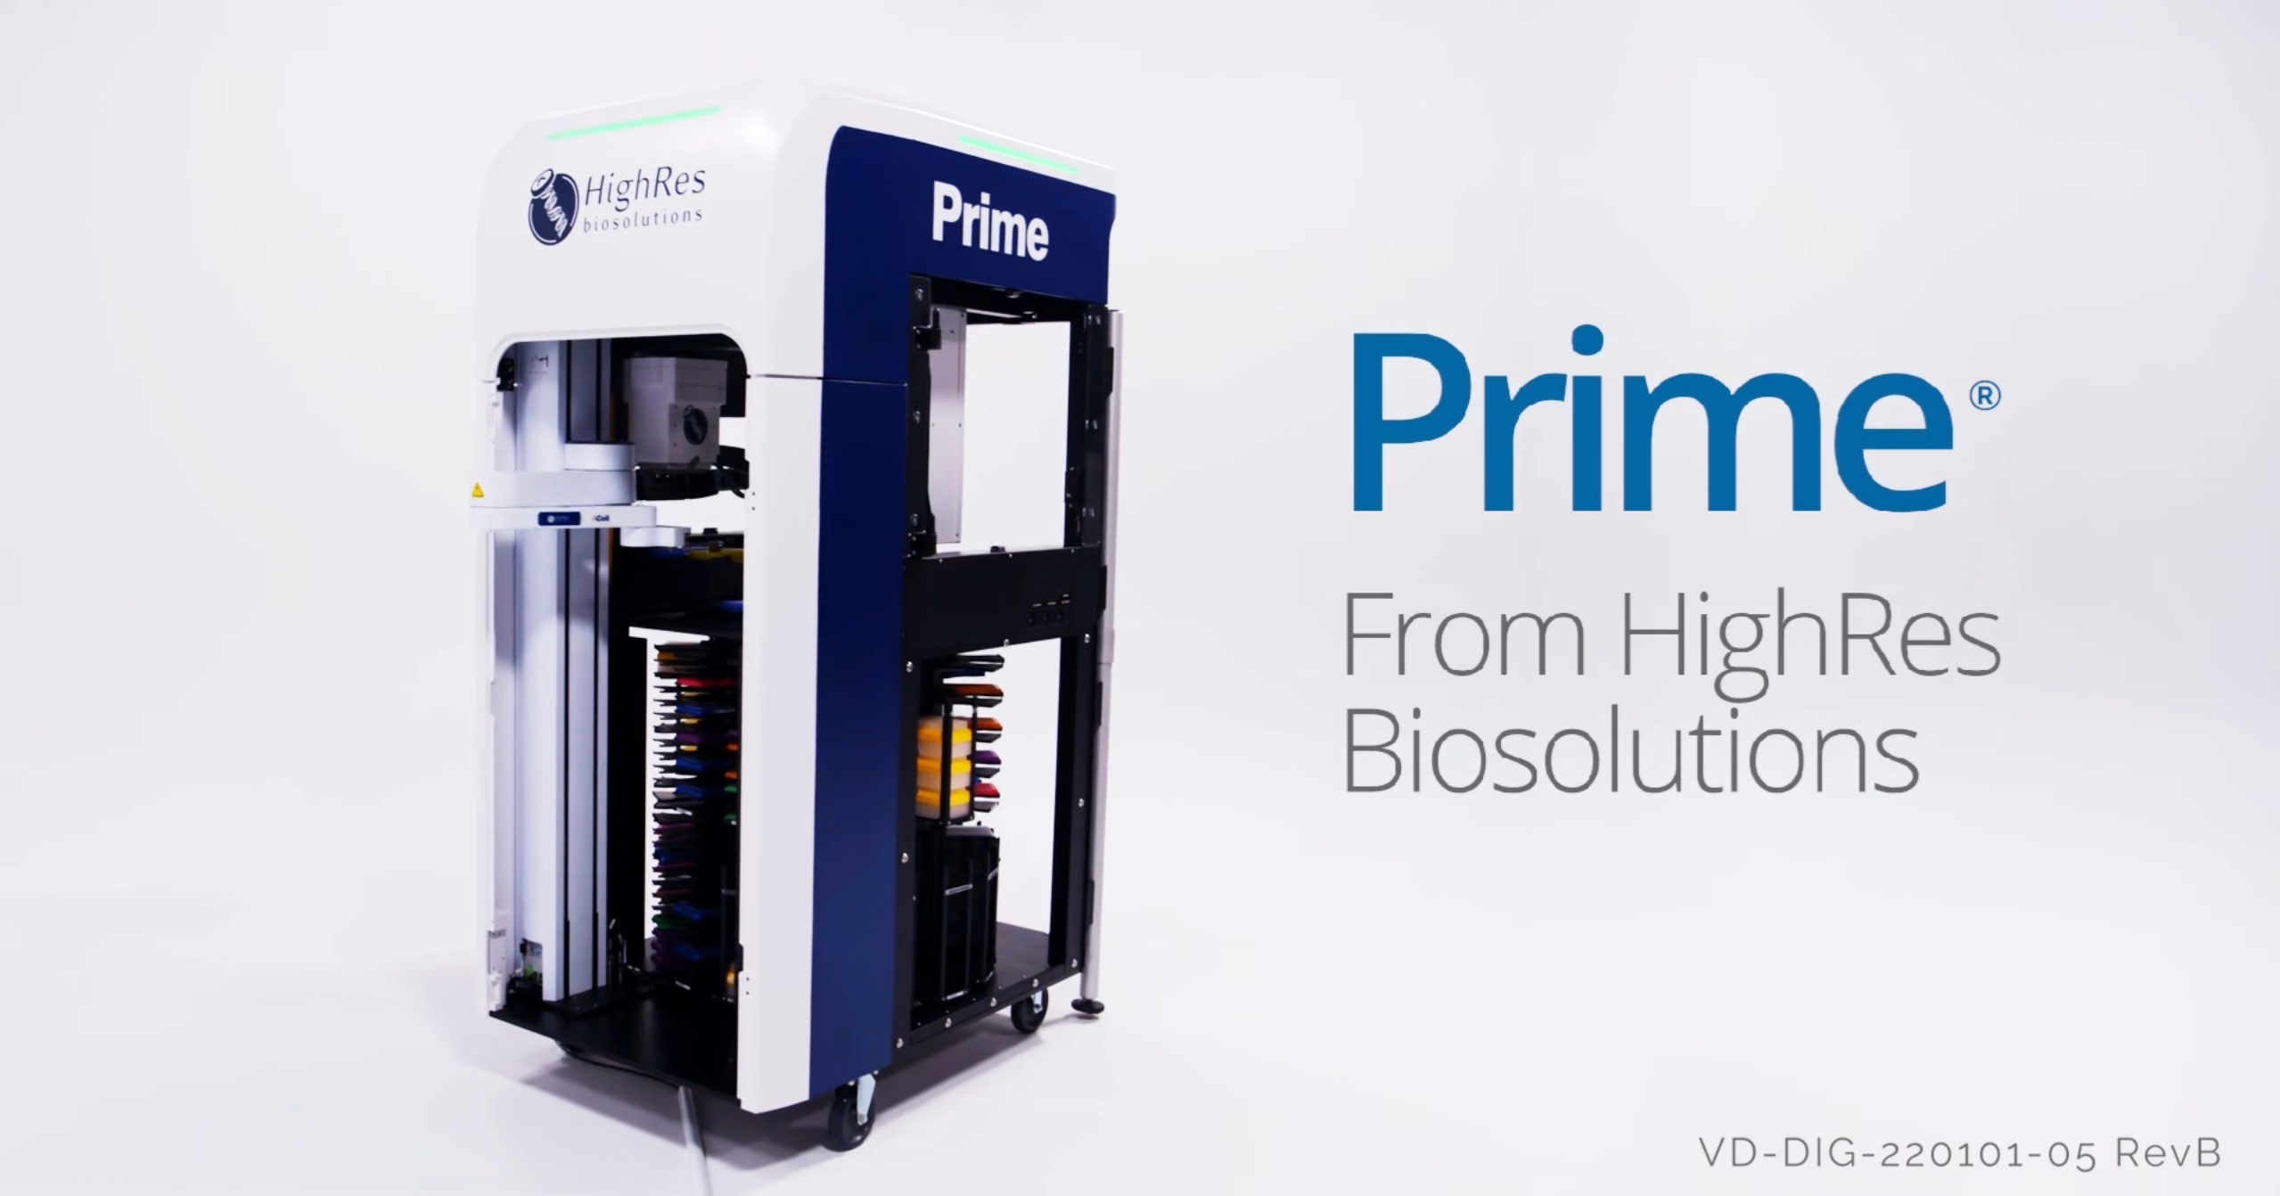
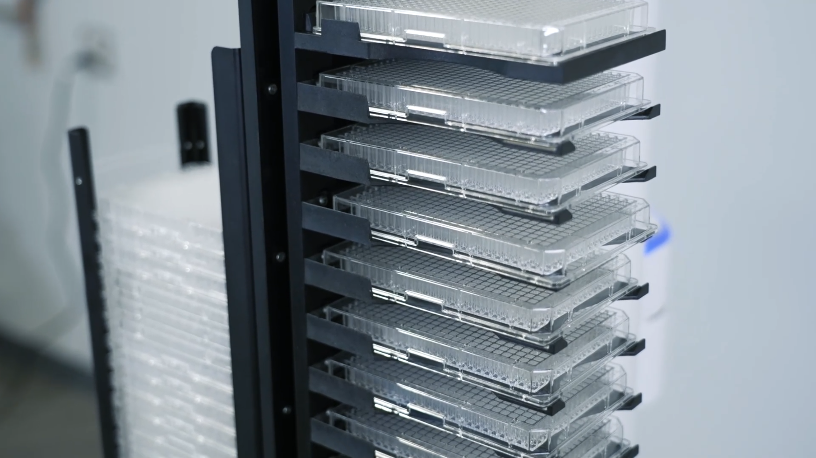
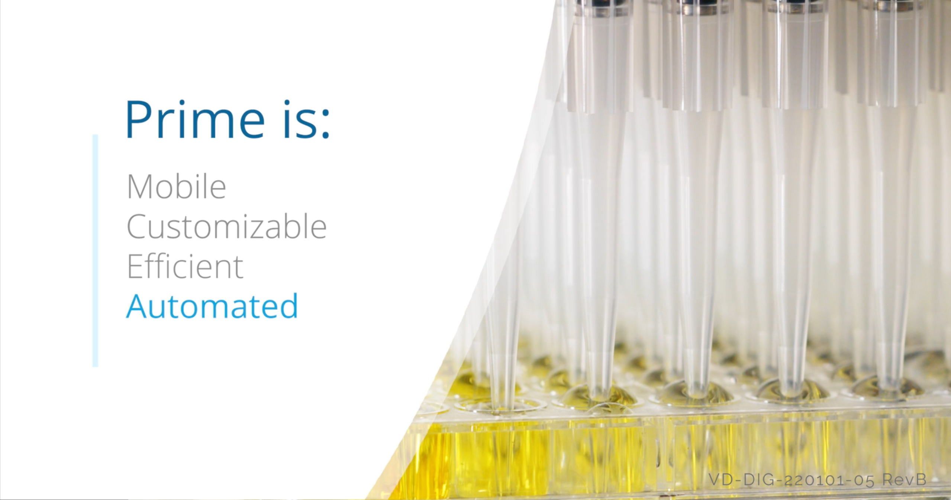
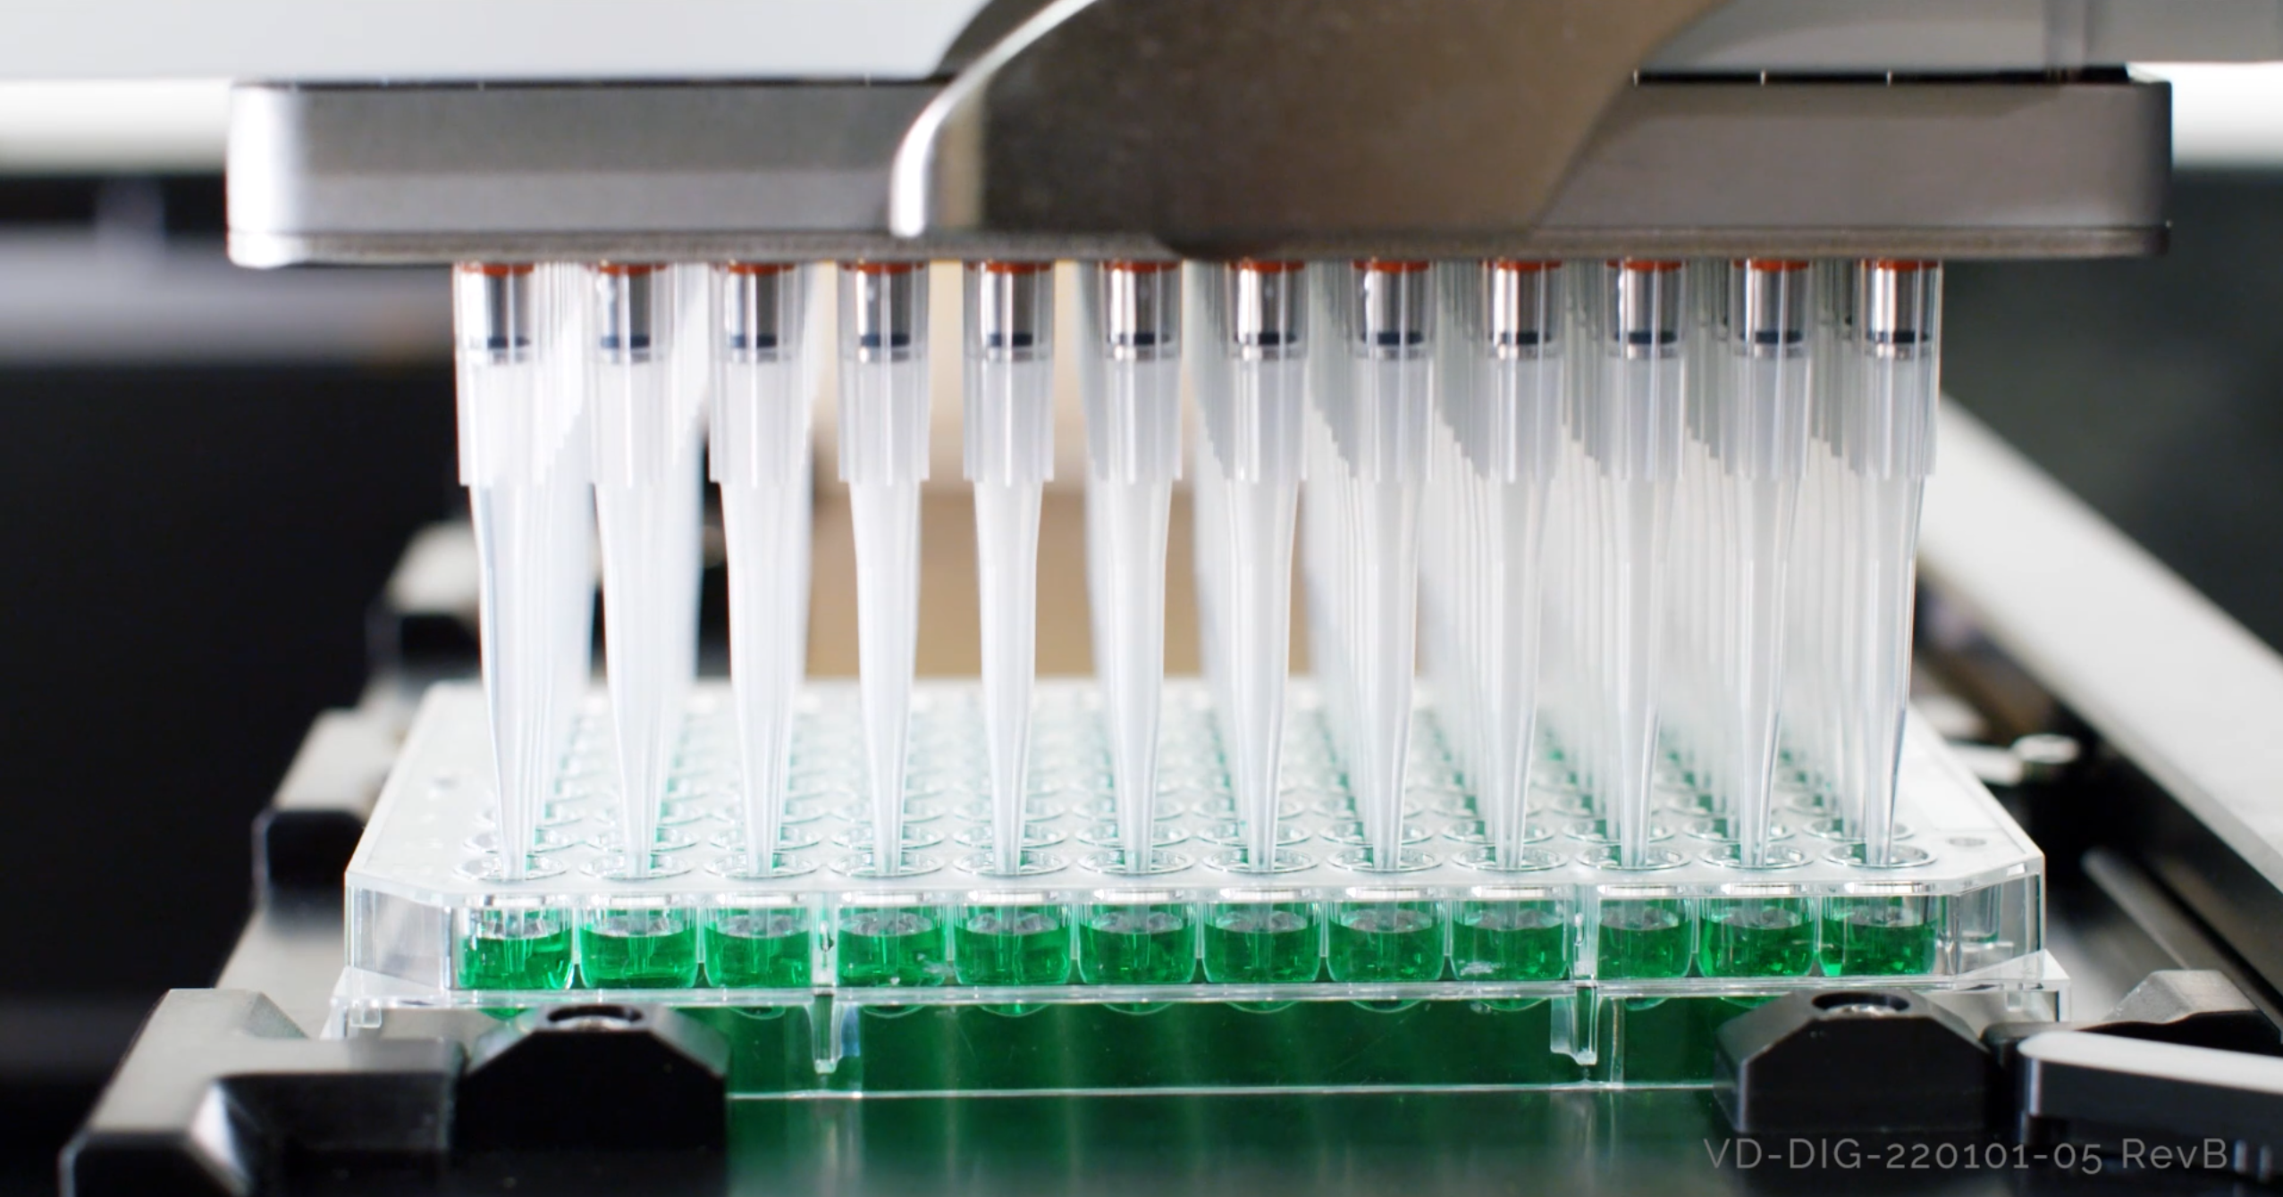
Product Promos Drive Engagement
HighRes® Biosolutions, a leading global laboratory automation company, was seeking to establish a marketing strategy to increase their engagement and drive results. Their team turned to Affirma for guidance on how to grow their Marketing efforts and put a tactical plan into place.
Our Work
Conducted market research to understand the client's audience and competitive landscape
Recommended the integration of video content across marketing efforts to enhance brand engagement
Initiated the strategy by repurposing existing product videos to drive audience engagement
Developed social shorts and looping videos to drive the audience to webinars and other CTAs
Gained client trust in the value of video to facilitate an on-site video shoot for a product launch
Continue to leverage and optimize video assets aligned with the client's marketing objectives
The Result
Achieved higher engagement and clicks on social channels with videos compared to images
Enhanced brand visibility and accessibility to a wider audience through strategic video marketing initiatives
Improved prospect conversion rates, search engine optimization (SEO), and content shareability

Slide 2
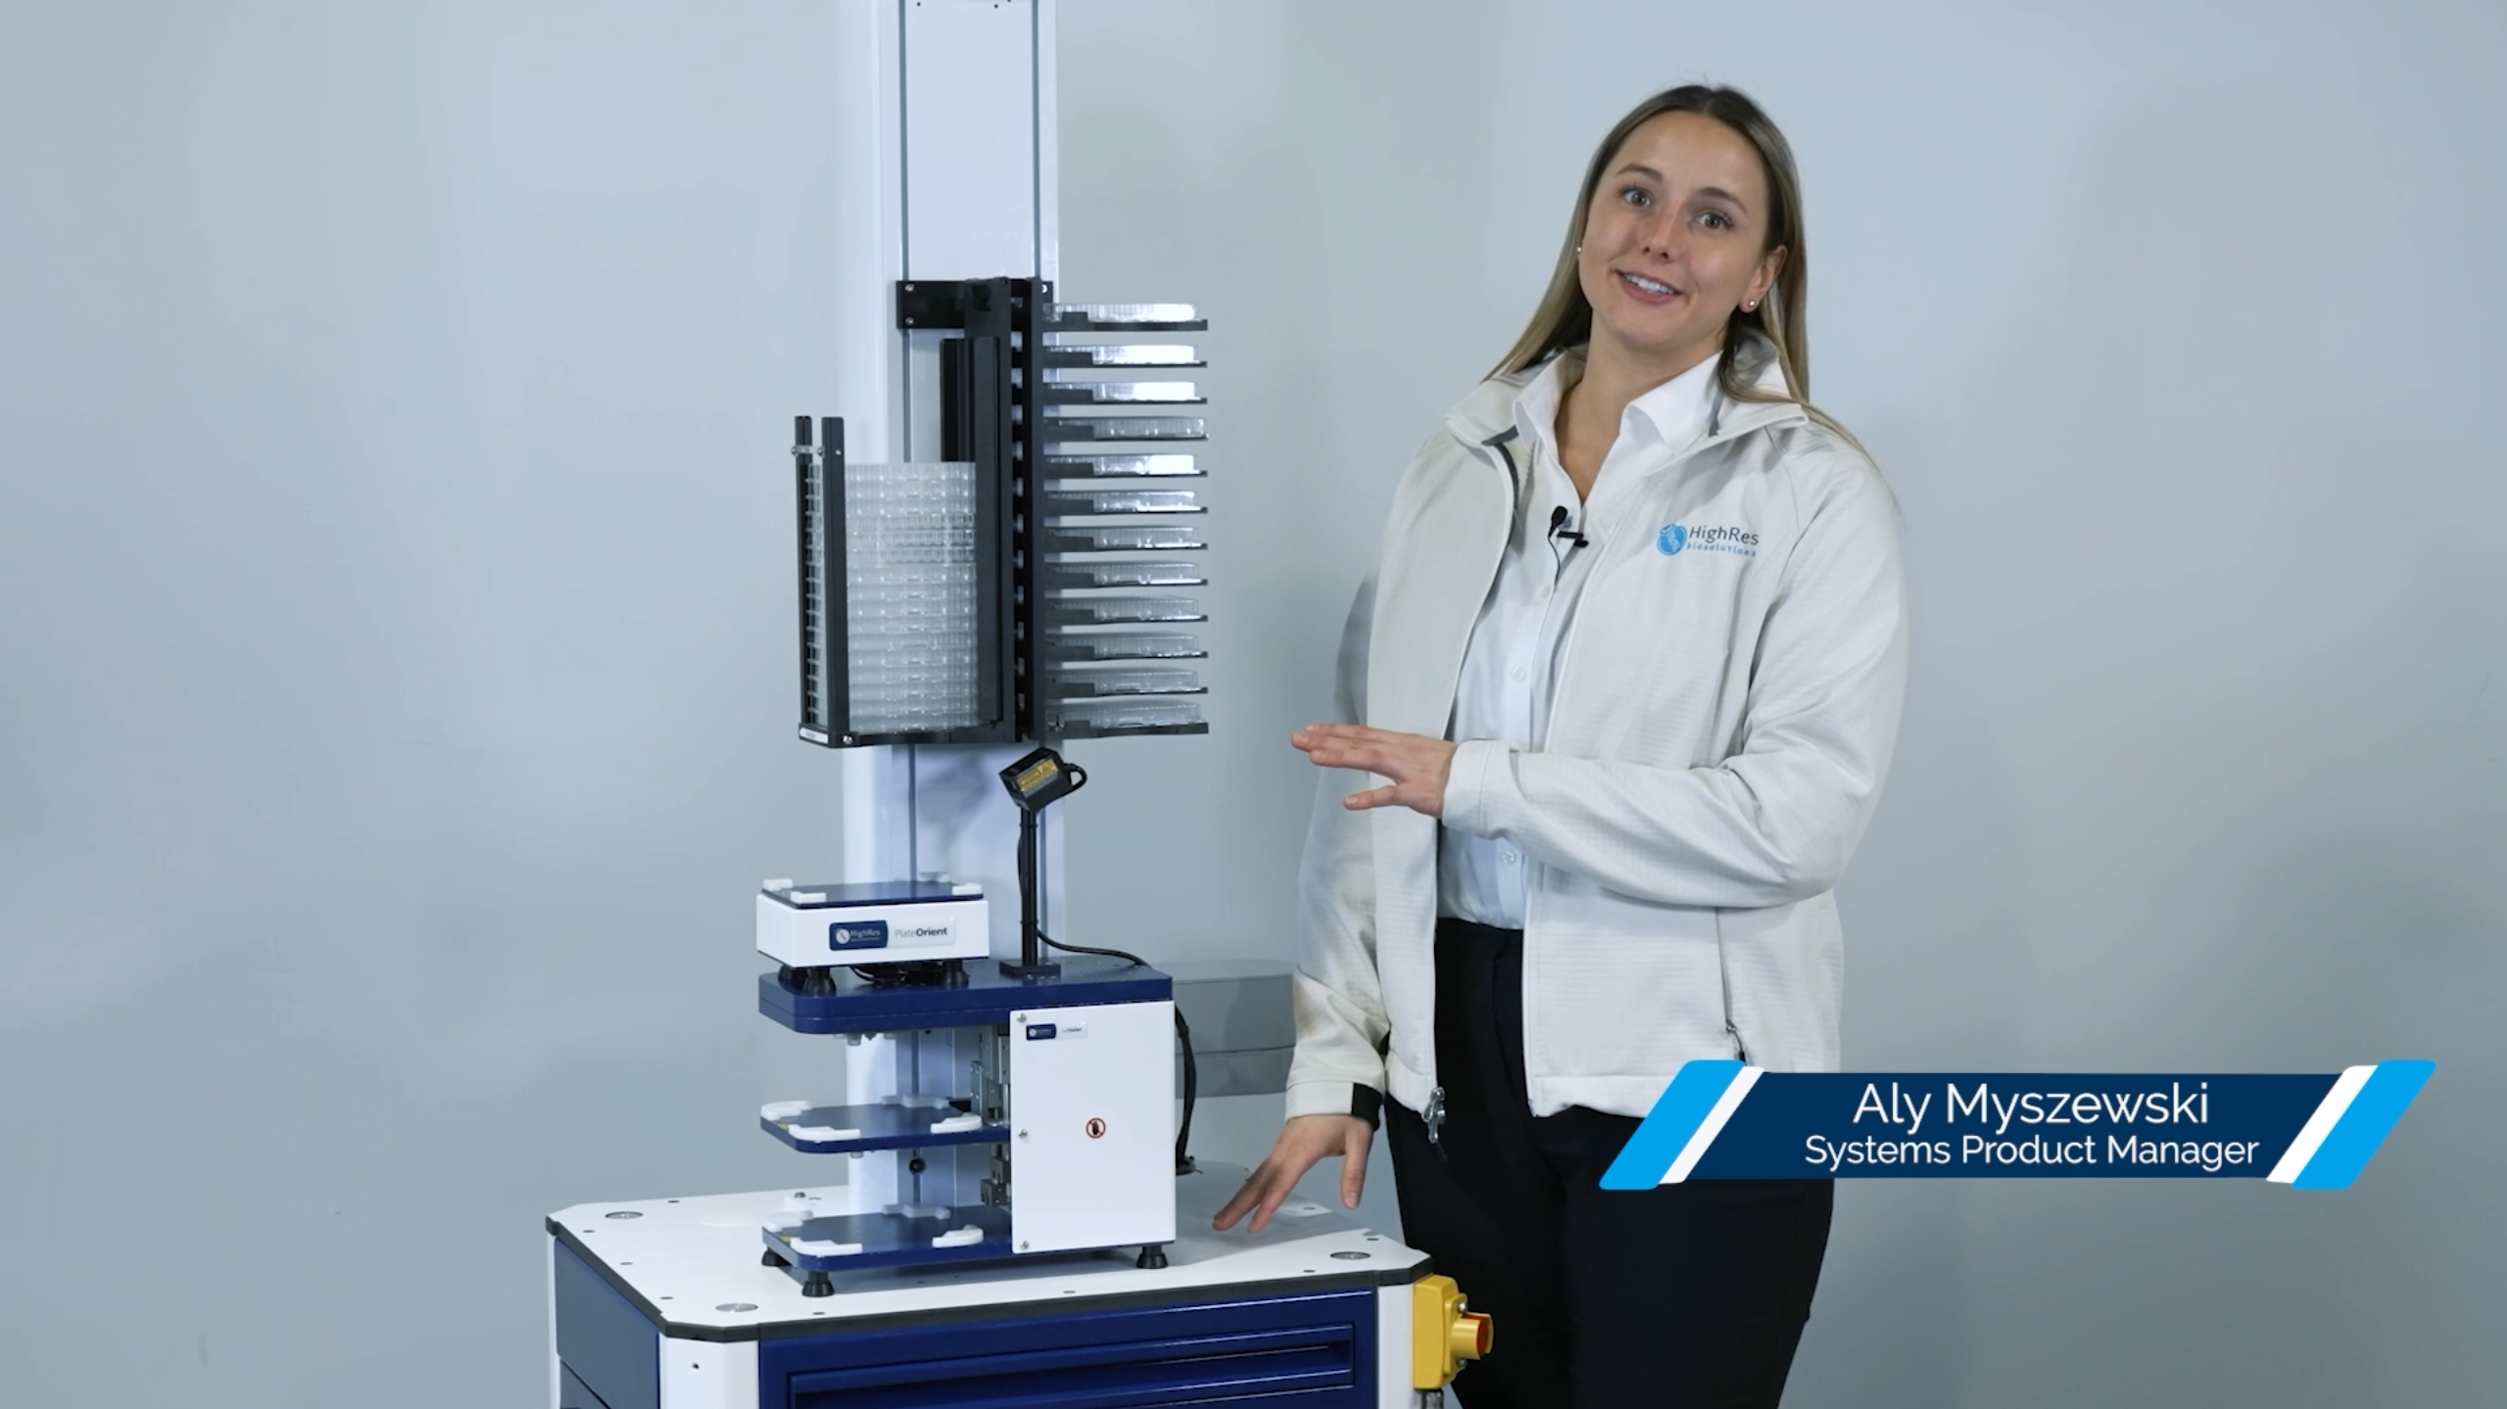
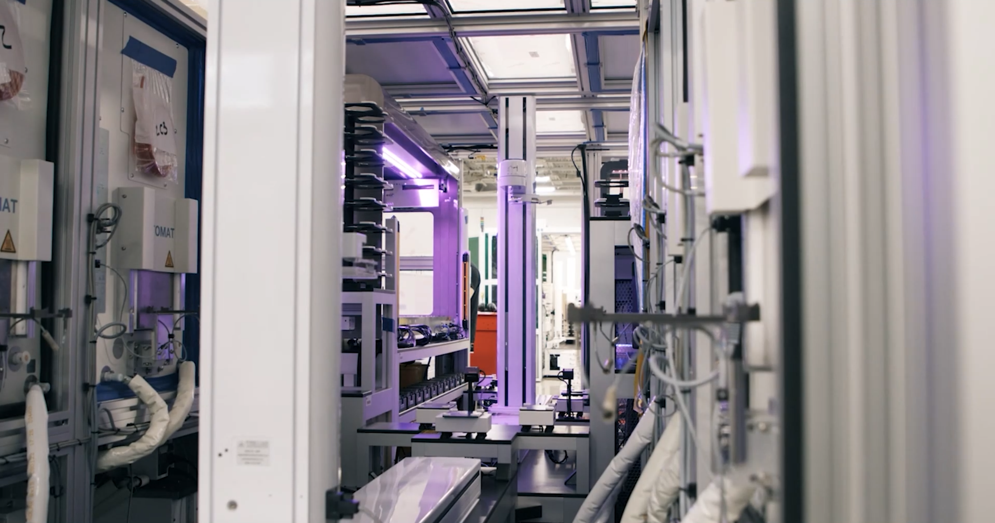
Types of Product Posts
Product promotions can be as simple as looping GIFs with CTA copy attached to a social post, or as complex as a full product overview with technician or customer testimonials included. HighRes has leveraged product promotions from across this spectrum to tailor their video content around their wider marketing strategy.
Product Launches
Social Sizzles
Loops/GIFs
3,120
76
5
100%
Avg. Views
Avg. Likes
Avg. Shares
% of posts
w/ comments

Slide 3
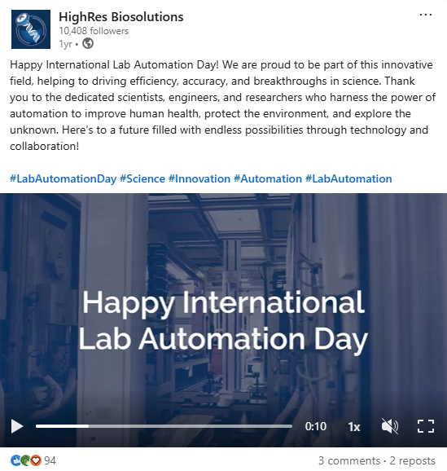
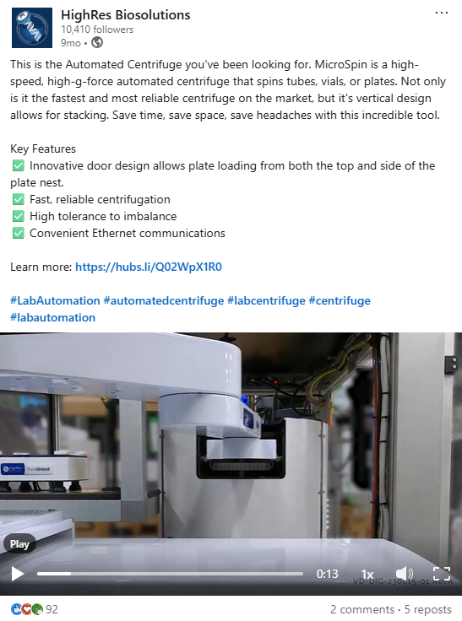
Product Promos Social Stats
HighRes® LinkedIn channel leveraged our videos across 6 social posts during FY24. All videos enhanced engagement with HighRes’ new product offerings and drew new visitors and clicks to HighRes social page and product website
Nucleus Equipment Loop
Introducing the FlexPod
Lab Automation Day GIF
4. Prime Liquid Handler Promo
5. Automated Centrifuge Loop
6. Device Driver Promo
3,814
389
303
Avg. Impressions
Avg. Engagement
Avg. Clicks
9.1%
7.2%
Engagement rate
Click-through rate

